Slide 1
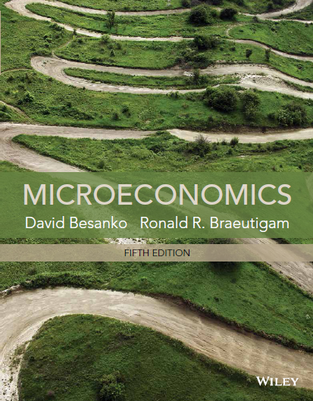
Chapter 9
Perfectly Competitive
Markets

Slide 2
Chapter Nine Overview
Introduction
Perfect Competition Defined
The Profit Maximization Hypothesis
The Profit Maximization Condition
Short Run Equilibrium
Short Run Supply Curve for the Firm
Short Run Market Supply Curve
Short Run Perfectly Competitive Equilibrium
Producer Surplus
Long Run Equilibrium
Long Run Equilibrium Conditions
Long Run Supply Curve
Chapter Nine

Slide 3
Perfectly Competitive Markets
A perfectly competitive market consists of firms that produce identical products that sell at the same price.
Each firm’s volume of output is so small in comparison to the overall market demand that no single firm has an impact on the market price.
Chapter Nine

Slide 4
Perfectly Competitive Markets - Conditions
A. Firms produce undifferentiated products in the sense that consumers perceive them to be identical
B. Consumers have perfect information about the prices all sellers in the market charge
Chapter Nine

Slide 5
Perfectly Competitive Markets - Conditions
C. Each buyer’s purchases are so small that he/she has an imperceptible effect on market price.
D. Each seller’s sales are so small that he/she has an imperceptible effect on market price. Each seller’s input purchases are so small that he/she perceives no effect on input prices
E. All firms (industry participants and new entrants) have equal access to resources (technology, inputs).
Chapter Nine

Slide 6
Implications of Conditions
The Law of One Price: Conditions (a) and (b) imply that there is a single price at which transactions occur.
Price Takers: Conditions (c) and (d) imply that buyers and sellers take the price of the product as given when making their purchase and output decisions.
Free Entry: Condition (e) implies that all firms have identical long run cost functions
Chapter Nine

Slide 7
The Profit Maximization Hypothesis
Definition: Economic Profit
Sales Revenue - Economic (Opportunity) Cost
Example:
Revenues: $1M
Costs of supplies and labor: $850,000
Owner’s best outside offer: $200,000
Chapter Nine

Slide 8
The Profit Maximization Hypothesis
“Accounting Profit”: $1M - $850,000 = $150,000
“Economic Profit”: $1M - $850,000 - $200,000 = -$50,000
Business “destroys” $50,000 of wealth of owner
Chapter Nine

Slide 9
The Profit Maximization Condition
Assuming the firm sells output Q, its economic profit is:
Where
TR(Q) = Total revenue from selling the quantity Q
TC(Q) = Total economic cost of producing the quantity Q
Chapter Nine

Slide 10
The Profit Maximization Condition
Since P is taken as given, firm chooses Q to maximize profit.
Marginal Revenue: The rate which TR change with output.
Since firm is a price taker, increase in TR from 1 unit change in Q is equal to P
Chapter Nine

Slide 11
The Profit Maximization Condition
Note:
If P > MC then profit rises if output is increased
If P < MC then profit falls if output is increased.
Therefore, the profit maximization condition for a price-taking firm is P = MC
Chapter Nine

Slide 12
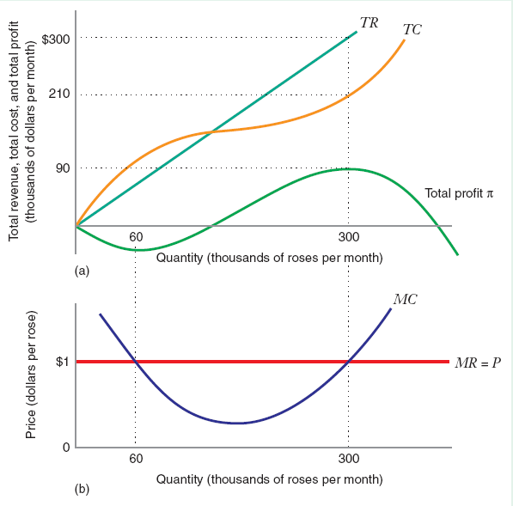
The Profit Maximization Condition
Chapter Nine

Slide 13
The Profit Maximization Condition
At profit maximizing point:
1. P = MC = MR
2. MC rising
“firm demand" = P (sells as much as likes at P)
“firm supply" defined by MC curve? Not quite:
Chapter Nine

Slide 14
Short Run Equilibrium
For the following, the short run is the period of time in which the firm’s plant size is fixed and the number of firms in the industry is fixed.
STC(Q) = SFC + NSFC + TVC(q) for q > 0
STC(Q) = SFC for q = 0
Chapter Nine

Slide 15
Short Run Equilibrium
Where:
SFC is the cost of the firm’s fixed input that are unavoidable at q = 0
Output insensitive for q > 0 = Sunk
NSFC is the cost of the firm’s inputs that are avoidable if the firm produces zero (salaries of some employees, for example)
Output insensitive for q > 0 = Non-sunk
TFC = SFC + NSFC
TVC(q) are the output sensitive costs (and are non-sunk)
Chapter Nine

Slide 16
Short Run Supply Curve (SRSC)
Definition: The firm’s Short run supply curve tells us how the profit maximizing output changes as the market price changes.
Short Run Supply Curve:
NSFC=0
If the firm chooses to produce a positive output, P = SMC defines the short run supply curve of the firm. But…
Chapter Nine

Slide 17
Shut Down Price
The firm will choose to produce a positive output only if:
π(q) > π(0) …or…
Pq – TVC(q) – TFC > -TFC ⬄
Pq – TVC(q) > 0 ⬄
P > AVC(q)
Definition: The price below which the firm would opt to produce zero is called the shut down price, Ps. In this case, Ps is the minimum point on the AVC curve.
Chapter Nine

Slide 18
Short Run Supply Function
Therefore, the firm’s short run supply function is defined by:
P=SMC, where SMC slopes upward as long as P > Ps
2. 0 where P < Ps
This means that a perfectly competitive firm may choose to operate in the short run even if economic profit is negative.
Chapter Nine

Slide 19
Short Run Supply Curve
$/yr
NSFC = 0
SMC
SAC
AVC
P_{s}
Quantity (units/yr)
Chapter Nine

Slide 20
Cost Considerations
At prices below SAC but above AVC, profits are negative if the firm produces…but the firm loses less by producing than by shutting down because of sunk costs.
Example:
STC(q) = 100 + 20q + q²
TFC = 100 (this is sunk)
TVC(q) = 20q + q²
AVC(q) = 20 + q
SMC(q) = 20 + 2q
Chapter Nine

Slide 21
Cost Considerations
The minimum level of AVC is the point where AVC = SMC or:
20+q = 20+2q
q = 0
AVC minimized at 20
The firm’s short run supply curve is, then:
P < Ps = 20: qs = 0
P > Ps = 20: P = SMC ⬄
P = 20+2q ⬄ qs = 10 + ½P
Chapter Nine

Slide 22
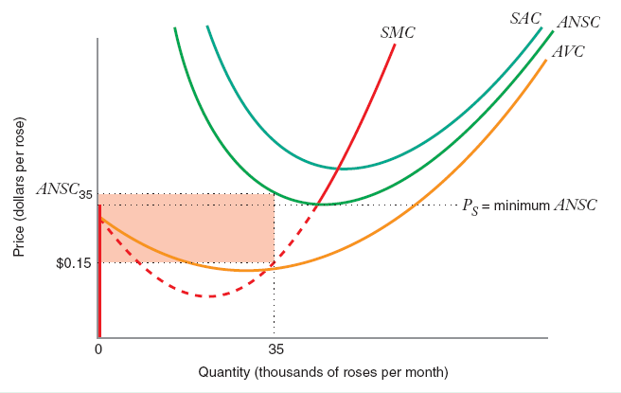
SRSC When Some Costs are Sunk and Some are Non-Sunk
TFC = SFC + NSFC, where NSFC > 0
ANSC = AVC + NSFC/Q
Now, the shut down price, Ps is the minimum of the ANSC curve.
Chapter Nine

Slide 23
SRSC When All Costs are Non-Sunk
If the firm chooses to produce a positive output, P = SMC defines the short run supply curve of the firm. But the firm will choose to produce a positive output only if:
π(q) > π(0) …or…
Pq – TVC(q) - TFC > 0 ⬄
P > AVC(q) + AFC(q) = SAC(q)
Now, the shut down price, Ps is the minimum of the SAC curve
Chapter Nine

Slide 24
SRSC When All Costs are Non-Sunk
$/yr
SMC
SAC
P_{s}
AVC
Quantity (units/yr)
Chapter Nine

Slide 25
SRSC When All Costs are Non-Sunk
STC(q) = F + 20q + q²
F = 100, all of which is sunk:
AVC(q) = 20 + q
SMC(q) = 20 + 2q
SAC(q) = 100/q + 20 + q
SAC = SMC at q = 10
Example:
At any P > 40, the firm earns positive economic profit
At any P < 40, the firm earns negative economic profit.
Chapter Nine

Slide 26
Market Supply and Equilibrium
Definition: The market supply at any price is the sum of the quantities each firm supplies at that price.
The short run market supply curve is the horizontal sum of the individual firm supply curves.
Chapter Nine

Slide 27
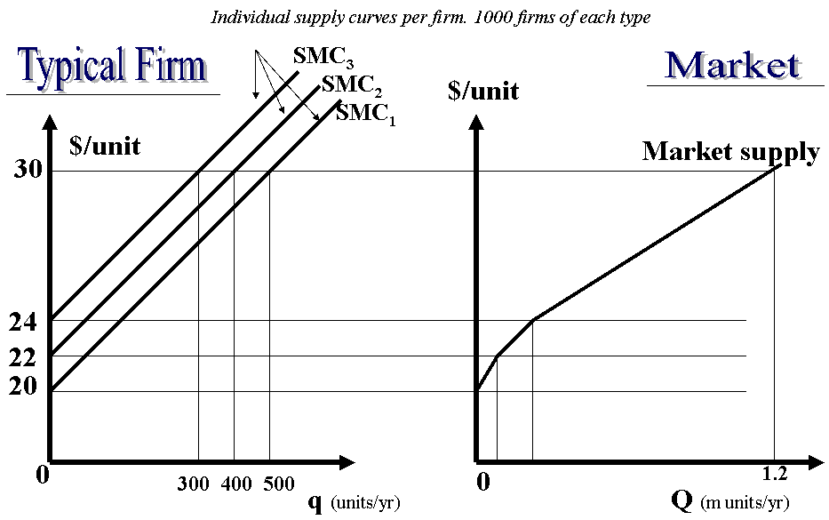
Short Run market & Supply Curves
Chapter Nine

Slide 28
Short Run Perfectly Completive Equilibrium
Definition: A short run perfectly competitive equilibrium occurs when the market quantity demanded equals the market quantity supplied.
and Q_{s}^{i}(P) is determined by the firm's individual profit maximization condition.
Chapter Nine

Slide 29
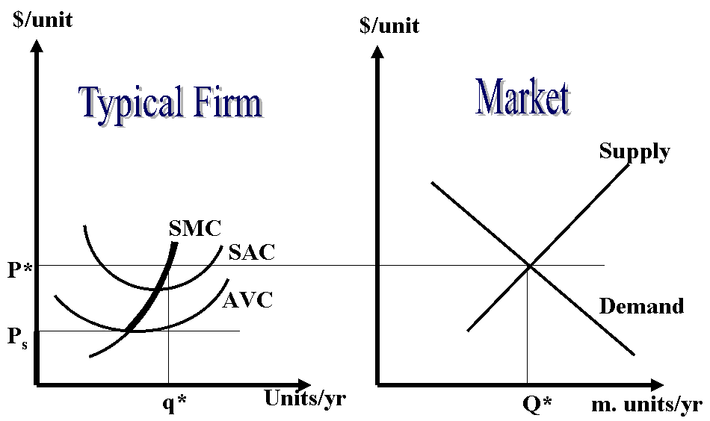
Short Run Perfectly Completive Equilibrium
Chapter Nine

Slide 30
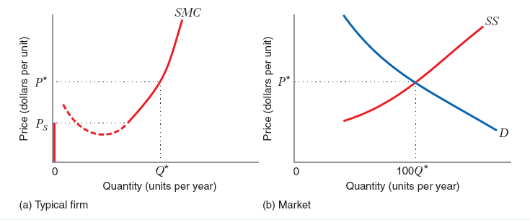
Short Run Market Equilibrium
Short-run perfectly competitive equilibrium: The market price at which quantity demanded equals quantity supplied.
Typical firm produces Q* where MR=MC and if 100 firms make up the market then market supply must equal 100Q*
Chapter Nine

Slide 31
Deriving a Short Run Market Equilibrium
300 Identical Firms
Q^{d}(P) = 60 – P
STC(q) = 0.1 + 150q²
SMC(q) = 300q
NSFC = 0
AVC(q) = 150q
Minimum AVC = 0 so as long as price is positive, firm will produce
Chapter Nine

Slide 32
Deriving a Short Run Market Equilibrium
Short Run Equilibrium
Profit maximization condition:
P = 300q
q^{s}(P) = P/300 and Q^{s}(P) = 300(P/300) = P
Q^{s}(P) = Q^{d}(P) ⬄ P = 60 – P
P*= 30
q* = 30/300=.1
Q* = 30
Chapter Nine

Slide 33
Deriving a Short Run Market Equilibrium
Do firms make positive profits at the market equilibrium?
SAC = STC/q = .1/q + 150q
When each firm produces .1, SAC per firm is: .1/.1 + 150(.1) = 16
Therefore, P* > SAC so profits are positive
Chapter Nine

Slide 34
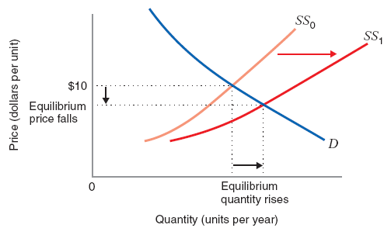
Comparative Statics
If Supply shifts when number of firms increase
Chapter Nine

Slide 35
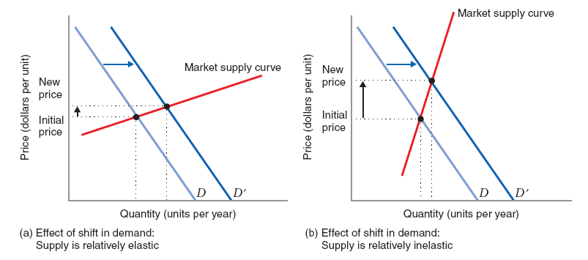
Comparative Statics
When demand shifts, elasticity of supply matters
Chapter Nine

Slide 36
Long Run Market Equilibrium
For the following, the long run is the period of time in which all the firm’s inputs can be adjusted. The number of firms in the industry can change as well.
The firm should use long run cost functions for evaluating the cost of outputs it might produce in this longer term period…i.e., decisions to modify plant size, enter or exit, change production process and so on would all be based on long term analysis
Chapter Nine

Slide 37
Long Run Market Equilibrium
$/unit
MC
SMC₀
AC
P
SAC₀
SAC₁
Example: Incentive to Change Plant Size
SMC₁
For example, at P, this firm has an incentive to change plant size to level K₁ from K₀:
q
(000 units/yr)
1.8
6
Chapter Nine

Slide 38
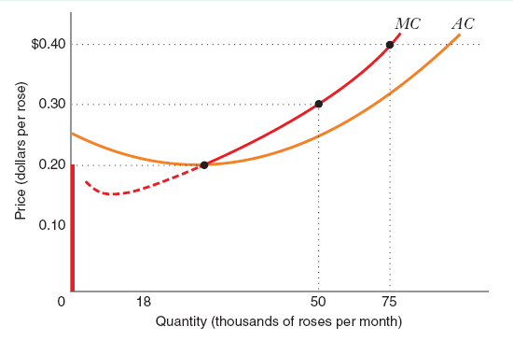
Firm’s Long Run Supply Curve
The firm’s long run supply curve:
P = MC for P > (min(AC) = Ps)
0 (exit) for P < (min(AC) = Ps)
For prices greater that $0.20 the long-run supply curve is the long-run MC curve.
Chapter Nine

Slide 39
Long Run Market Equilibrium
A long run perfectly competitive equilibrium occurs at a market price, P*, a number of firms, n*, and an output per firm, q* that satisfies:
Long run profit maximization with respect to output and plant size:
P* = MC(q*)
Zero economic profit
P* = AC(q*)
Demand equals supply
Q^{d}(P*) = n*q* …or…
n* = Q^{d}(P*)/q*
Chapter Nine

Slide 40
Long Run Perfectly Competitive
$/unit
$/unit
Typical Firm
Market
n* = 10,000,000/50,000=200
MC
Market demand
SAC
AC
P*
SMC
q*=50,000
q
Q*=10M.
Q
Chapter Nine

Slide 41
Calculating Long Run Equilibrium
TC(q) = 40q - q² + .01q³
AC(q) = 40 – q + .01q²
MC(q) = 40 – 2q + .03q²
Q^{d}(P) = 25000-1000P
The long run equilibrium satisfies the following:
a. P* = 40 – 2q* - .03q*²
b. P* = 40 – q* + .01q*²
c. 25000-1000P* = q*n*
Chapter Nine

Slide 42
Calculating Long Run Equilibrium
Using (a) and (b), we have:
40 – 2q* + .03q*² = 40-q*+.01q*²
q* = 50
P* = 15
Q^{d}(P*) = 10000
Using (c ) we have:
n* = 10000/50 = 200
Chapter Nine

Slide 43
Calculating Long Run Equilibrium
Summarizing long run equilibrium – “If anyone can do it, you can’t make money at it”
Or if the firm’s strategy is based on skills that can be easily imitated or resources that can be easily acquired, in the long run your economic profit will be competed away.
Chapter Nine

Slide 44
Long Run Market Supply Curve
We have calculated a point at which the market will be in long run equilibrium. This is a point on the long run market supply curve. This curve can be derived explicitly, however.
Definition: The Long Run Market Supply Curve tells us the total quantity of output that will be supplied at various market prices, assuming that all long run adjustments (plant, entry) take place.
Chapter Nine

Slide 45
Long Run Market Supply Curve
Since new entry can occur in the long run, we cannot obtain the long run market supply curve by summing the long run supplies of current market participants
Instead, we must construct the long run market supply curve.
We reason that, in the long run, output expansion or contraction in the industry occurs along a horizontal line corresponding to the minimum level of long run average cost.
If P > min(AC), entry would occur, driving price back to min(AC)
If P < min(AC), firms would earn negative profits and would supply nothing
Chapter Nine

Slide 46
Long Run Market Supply Curve
Market
$/unit
$/unit
n** = 18M/52,000 = 360
Typical Firm
SS₀
SS₁
D₁
MC
D₀
SAC
AC
23
15
LS
SMC
q (000s)
50 52
10 18
Chapter Nine
Q (M.)

Slide 47
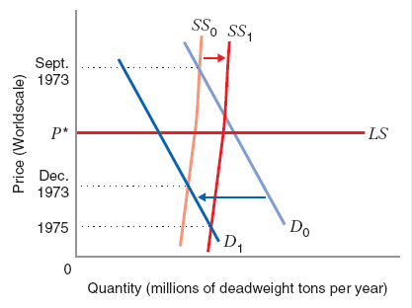
Constant Cost Industry
Constant-cost Industry: An industry in which the increase or decrease of industry output does not affect the price of inputs.
Chapter Nine

Slide 48
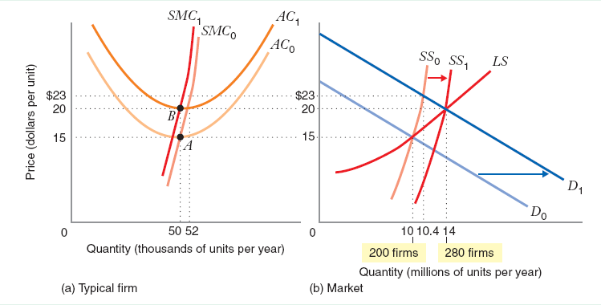
Increasing Cost Industry
Increasing cost Industry: An industry which increases in industry output increase the price of inputs. Especially if firms use industry specific inputs i.e. scarce inputs that are used only by firms in a particular industry and no other industry.
Chapter Nine

Slide 49
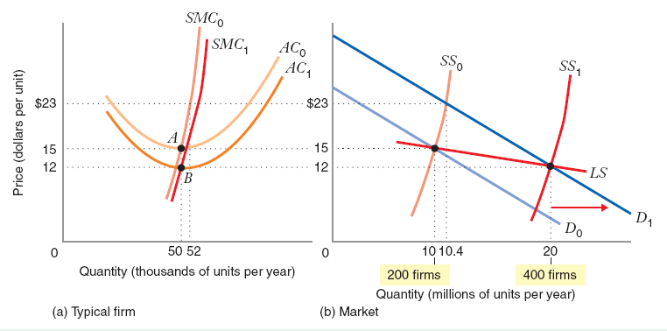
Decreasing Cost Industry
Decreasing-cost Industry: An industry in which increases in industry output decrease the prices of some or all inputs.
Chapter Nine

Slide 50
Producer Surplus
Definition: Producer Surplus is the area above the market supply curve and below the market price. It is a monetary measure of the benefit that producers derive from producing a good at a particular price.
Note:
…that the producer earns the price for every unit sold, but only incurs the SMC for each unit. This is why the difference between the P and SMC curve measures the total benefit derived from production.
Chapter Nine

Slide 51
Producer Surplus
Further, since the market supply curve is simply the sum of the individual supply curves…which equal the marginal cost curves the difference between price and the market supply curve measures the surplus of all producers in the market.
…that producer’s surplus does not deduct fixed costs, so it does not equal profit.
Note:
Chapter Nine

Slide 52
Producer Surplus
P
Market Supply Curve
P*
Producer Surplus
Q
Chapter Nine

Slide 53
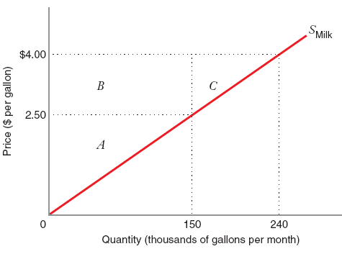
Producer Surplus
Given Market supply curve and P is the price in dollars per gallon
Find producer surplus when price is $2.50 per gallon
How much does producer surplus when price of milk increases from $2.50 to $4.00
Chapter Nine

Slide 54
Producer Surplus
When the price is $2.50 per gallon, 1,50,000 gallons of milk are sold per month.
Producer surplus is triangle A
Price increases from $2.50 to $4.00 the quantity supplied will increase to 240,000 gallons per month
Producer surplus will increase by areas B and area C
Chapter Nine

